Slide 1
NLP
Topic 3: Extraction of Narratives from Online News
‘propaganda detection’
Subtask 2: Narrative Classification
Group 8 "Word Wizards"
Denis Bugaenco Iulia Mihaela Enache Raquel Panadero Palenzuela Tatiana Beliaeva

Slide 2
Project structure
data/:
raw-documents/: Original documents.
traditional or deeplearning processed-documents/: Preprocessed documents for models.
subtask-2-annotations/: Annotations for each txt file.
labels/JSON files for narratives and subnarratives used in modeling.
datasets/: contains the NarrativeDataset.py and DeepLNarrativeDataset.py classes for traditional and dl models.
model performance analysis/: Includes notebooks for Quantitative, Qualitative and Interpretability analysis.
models/: Contains the implementation of baseline models.
lstm.py: Implementation of the LSTM model.
svm.py: Implementation of the SVM model.
transformer.py: Implementation of the Transformer model.
bert.py: Implementation of Bert.
bertru.py: Implementation of Bert with russian predtrained model.
notebooks/: Exploratory notebooks for data analysis and visualization.
preprocessing/: Scripts for cleaning and processing data.
predictions/: Stores predictions generated by baseline models for each topic.
trainer/: Includes helper files for training and evaluation.
loss.py: Custom loss functions.
scheduler.py: Learning rate schedulers.
trainer.py: Main trainer class.
base_config.py: Configuration file for setting up and running baseline experiments.
baselines.py: Script for training and evaluating baseline models.
utils.py: Script for predictions formatting, saving classification reports, and generating metrics.

Slide 3
Dataset Characteristics
Topics:
Climate Change (CC): Focuses on narratives related to environmental issues, policy framing, and activism.
War in Ukraine (UA): Involves narratives on geopolitical conflict, humanitarian concerns, and military actions.
Labels and Sublabels:
Each topic is classified into high-level labels (e.g., "criticism of climate policies," "discrediting Ukraine").
Sub-labels break down narratives into more specific categories (e.g., "climate policies are ineffective" or "Ukraine is a puppet of the West").
Class Structure:
Multi-label setup: A single text can belong to multiple labels or sub-labels (e.g., a news article might combine "activism" and "policy framing").
Class imbalance: Some labels have significantly fewer samples, posing challenges for model training.
Languages Covered: Bulgarian, English, Hindi, Portuguese, and Russian
Project goal: The goal of the project is to identify and classify text narratives related to Climate Change (CC) and War in Ukraine (UA), focusing on understanding how information is framed and communicated through distinct topics and subcategories

Slide 4
Data analysis and translation
Bulgarian and Portuguese to American English was translated using DeepL API.
Hindi to American English was Translated using Google Cloud Translation API (Hindi is not supported by DeepL).
We had an idea to use translated data for model training, but due to data imbalance across languages it turned out ineffective (the results of training with additional data are presented in the evaluation part)
Ranking of Translated Datasets (based on the average word frequency vector of each language):
1. HI: 0.8957 2. BG: 0.8238 3. PT: 0.6632
Lang. | Number of Files | Average File Length (characters) | Average Vocabulary Size (unique words) | Average Sentence Length (tokens)
EN | 200 | 3156.74 | 282.35 | 26.62
BG | 211 | 1928.32 | 182.68 | 24.54
PT | 200 | 2362.39 | 215.21 | 29.57
HI | 115 | 3677.95 | 273.60 | 21.69

Slide 5
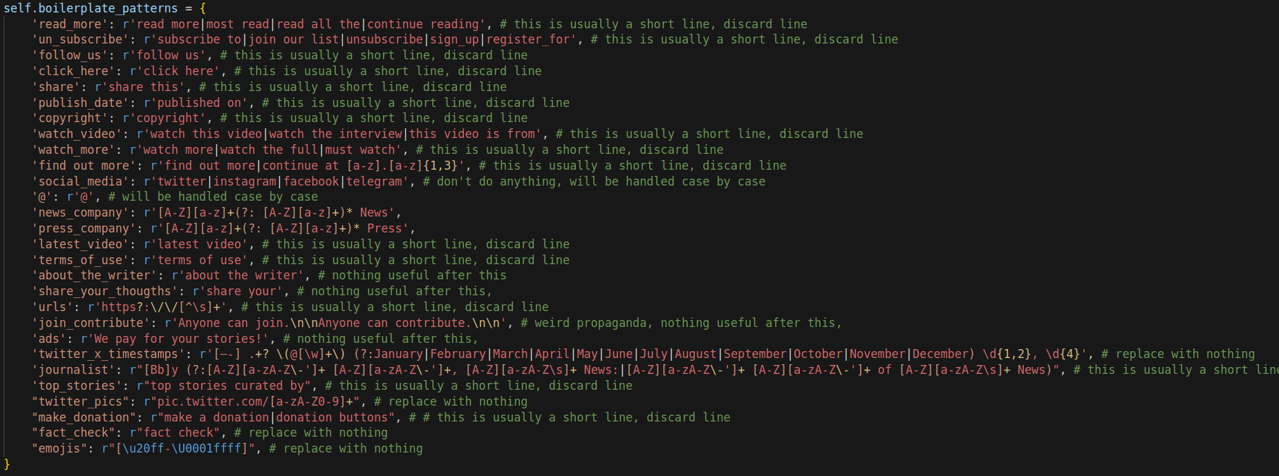
Data preprocessing
News preprocessing (especially in EN documents):
A lot of social media links, promo, ads, subscribe button texts, etc. that are not useful → remove
Somehow, one of these is frowned upon (tar sands), but the other three- cobalt, nickel and lithium mines (necessary for EV batteries) are “green”? 🤔 pic.twitter.com/iahDDqZRls — Patrick De Haan ⛽️📊 (@GasBuddyGuy) November 11, 2021
Sign up to get unfiltered news delivered straight to your inbox. You can unsubscribe any time. By subscribing you agree to our Terms of Use.

Slide 6
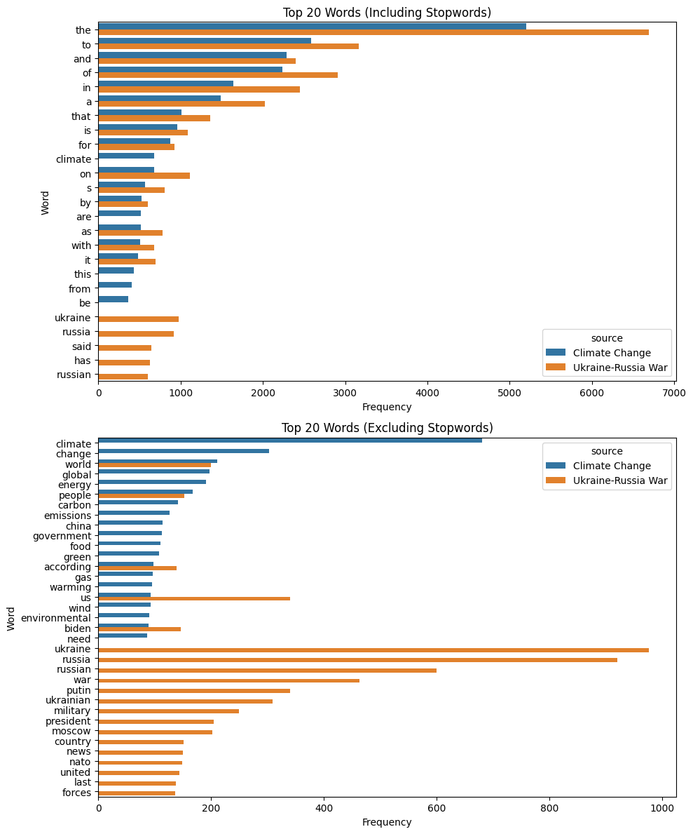
Data preprocessing
Step 1: Language-specific preprocessing, handled by scripts using Stanza's NLP pipeline for tokenization and custom boilerplates removal.
Processed output (in CoNLL format):
Traditional Models: Processed files in lower text with stopwords and punctuation removed
Deep Learning Models: Retained original text

Slide 7
Data preprocessing
Step 2: We build a dataset for each topic (CC and UA) to train models separately. Depending on the type of model (traditional or deep learning), we preprocess the data differently to suit their requirements.
Traditional Methods
Each sample (document) is represented as an array of lemmas.
Lemmas are extracted from the CoNLL format, using the lemma field instead of the token form.
This representation ensures linguistic normalization and reduces variability in the data.
Deep Learning Models (LSTM & Transformer Encoder)
We build a custom vocabulary class that maps tokens (token forms from the CoNLL format) to unique indexes.
Each document is converted into an array of token indexes instead of raw tokens.
Documents are padded to a fixed max_length for efficient batch training.
Pre-trained BERT (Hugging Face)
We use Hugging Face BERT Tokenizer to directly processes raw document data. Automatically handles padding and truncation to a fixed max_length.
Converts documents into token IDs compatible with the pre-trained BERT model.
Notes:
Step two of our process involved building the dataset to train our models. But how we built the dataset was different depending on the type of model to train:
For traditional methods, we represented each document as an array of lemmas. These lemmas were extracted from the CoNLL format by using the lemma field instead of the token form. This approach provided linguistic normalization, reducing variability in the data and improving model consistency.
For deep learning models, we created a custom vocabulary class to map tokens—based on the token forms from the CoNLL format—to unique indexes. Each document was then converted into an array of token indexes. To ensure efficient batch training, we padded all documents to a fixed maximum length.
For pre-trained BERT models, we utilized the Hugging Face BERT Tokenizer, which allowed us to process raw document data directly. This tokenizer automatically handled padding and truncation to a fixed maximum length and converted documents into token IDs compatible with the pre-trained BERT model.

Slide 8
Baselines
Model | Input | Implementation | Strengths | Weaknesses
SVM | TF-IDF features | Library: Scikit-learn TfidfVectorizer to extract text features (with max_features for dimensionality reduction) OneVsRestClassifier wraps SVC() → one binary classifier per label | Efficient for small datasets Works well with sparse features | - Struggle with scalability - Relies on feature engineering - Does not consider sequential information
LSTM | Tokenized indexes | Library: PyTorch - nn.Embedding for token embeddings - nn.LSTM for recurrent sequence modeling (outputs the last hidden state for classification) - nn.Linear for output layer | Captures sequential and long-term dependencies | Computationally expensive for long sequences
Transformer | Tokenized indexes + Positional Encoding + [CLS]token | Library: PyTorch - nn.Embedding for token embeddings - nn.TransformerEncoder for MHSA transformer layers - The final [CLS] token representation is passed through a linear layer for classification | Captures sequential and long-term dependencies Faster than RNNs Interpretability | Needs large datasets for effective training Computational costs
BERT | Tokenized indexes + Positional Encoding + [CLS]token | Library: Hugging Face Transformers - Pre-trained model (bert-base-uncased) initialized with AutoModelForSequenceClassification and problem_type="multi_label_classification" | - Leverages pre-trained knowledge - Minimal preprocessing needed | Might not fine-tune properly to a specific task
Notes:
These are the models that we decided to implement:
SVM uses TF-IDF features with Scikit-learn. We extracted features with TfidfVectorizer and trained one binary classifier per label using OneVsRestClassifier. It’s efficient for small datasets and works well with sparse features but struggles with scalability
LSTM takes tokenized indexes as input. We use the pytorch LSTM module and take the last hidden state as input into the classification head
Transformer we manually add a CLS learnable token, and we use the TransformerEncoder module from pytorch. the problem with this architecture is that we need lot of data for it to learn
BERT

Slide 9
Training
Models are run through the script with config with next parameters
example:
model: 'bert'
epochs: 20
batch_size: 8
lr: 5e-5
val_split: 0.2
During training metrics such as Loss (from loss.py), Accuracy, Precision, Recall and F1-score (from trainer.py) are observed in each epoch.
As an output of training, we get predicted labels for UA and CC topics separately with classification report and confusion matrix for analysis generated by utils.py.

Slide 10
Baseline for russian data
Model | Input | Implementation | Strengths | Weaknesses
BERTRU | Tokenized indexes + Positional Encoding + [CLS] token | Library: Hugging Face Transformers - Pre-trained model (DeepPavlov/rubert-base-cased) initialized with AutoModelForSequenceClassification for multi-label classification | Tailored for Russian texts, effective for specific narratives Leverages language-specific pre-trained knowledge | Over-labels Needs better data and refinement for task-specific tuning
We also made changes in the add_annotations function of deepl_dataset.py to map UA to URW as a fallback topic and ensure proper file matching and annotation filtering for Russian-specific data.
The model effectively identifies key themes but struggles with overgeneralization and misclassification, particularly in underrepresented classes. Moderate F1 scores for prominent categories (e.g., 0.77 for Discrediting Ukraine) contrast with zeros in others.The weighted F1 score of 0.43 and low accuracy of 0.037 highlight the need for balanced data and refined training strategies.

Slide 11
Evaluation
Baseline results for English - Subtask 2 from the SemEval 2025 leaderboard
 | Model | F1 Macro Coarse | F1 Std. Dev. Coarse | F1 Macro Fine | F1 Std. Dev. Fine
1 | LSTM | 0.19400 | 0.21300 | 0.26800 | 0.44300
2 | LSTM EN+BG (translated) | 0.20900 | 0.23100 | 0.19400 | 0.36100
3 | LSTM EN+HI (translated) | 0.22600 | 0.27600 | 0.06700 | 0.18100
4 | SVM | 0.22400 | 0.25000 | 0.19900 | 0.32000
5 | Basic Transformer | 0.22300 | 0.21100 | 0.16000 | 0.20700

Slide 12
Quantitative Evaluation
For a better interpretability, the quantitative analysis of the implemented models is divided into two macro-categories: Climate Change ( CC) and War in Ukraine (UA).
Climate Change ( CC)
War in Ukraine (UA)
 | Model | Micro F1 | Weighted F1 | Accuracy
1 | BERT | 0.46 | 0.38 | 0.44
2 | Long Short-Term Memory | 0.40 | 0.62 | 0.00
3 | Support Vector Machine | 0.40 | 0.56 | 0.23
4 | Transformer | 0.35 | 0.62 | 0.00
 | Model | Micro F1 | Weighted F1 | Accuracy
1 | BERT | 0.40 | 0.27 | 0.51
2 | Support Vector Machine | 0.28 | 0.17 | 0.10
3 | Long Short-Term Memory | 0.27 | 0.13 | 0.00
4 | Transformer | 0.27 | 0.15 | 0.00

Slide 13
Qualitative Evaluation
For example let's take the predictions of all models for this text EN_CC_100093
Text Summary The text focuses on discussions at the World Economic Forum (WEF) on "Disease X," covering topics like global health surveillance, private-sector involvement, and international cooperation through the WHO. It includes quotes from key figures, criticisms of international processes, and mentions of controversies, such as supposed WHO voting issues and critiques of AstraZeneca’s vaccine development.
True labels : Other Other
LSTM | SVM | BERT | Transformer
Predicted Output: Other CC: Criticism of institutions and authorities CC: Criticism of institutions and authorities: Criticism of national governments | Other | Other | Predicted Output: Other CC: Criticism of climate movement CC: Criticism of institutions and authorities CC: Criticism of institutions and authorities: Criticism of national governments CC: Hidden plots by secret schemes of powerful groups: Blaming global elites

Slide 14
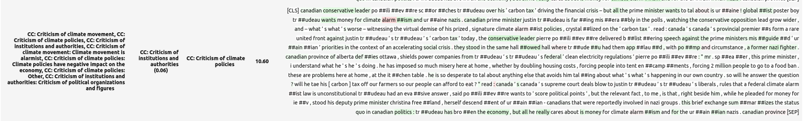
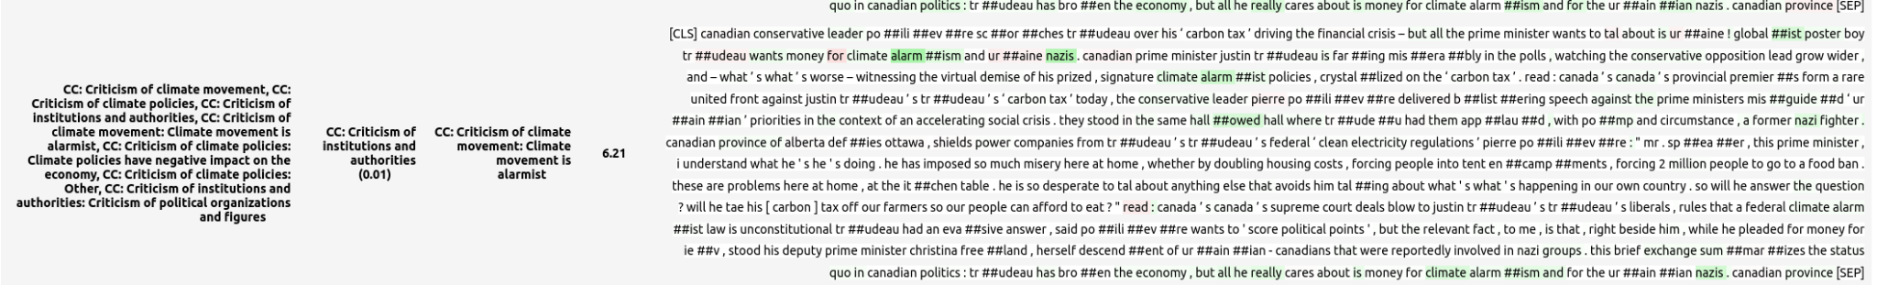

BERT Interpretability: Climate Change
Implemented with

Slide 15
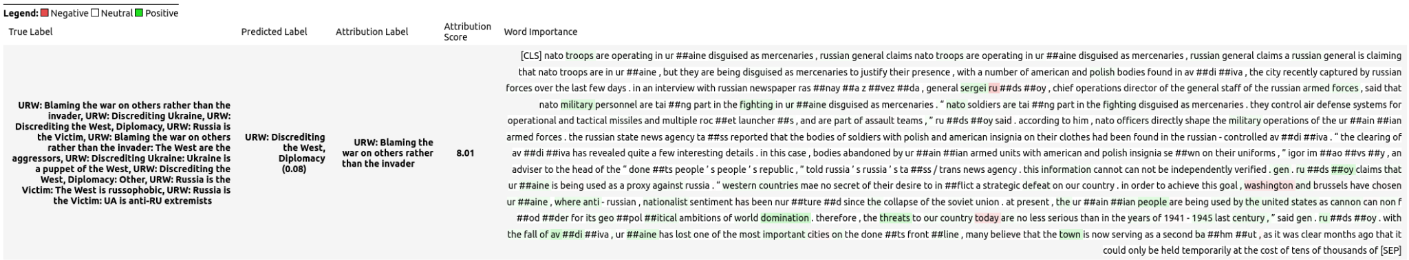
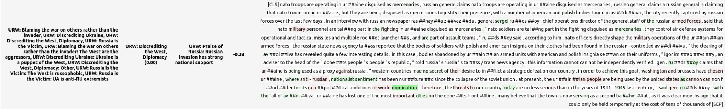
BERT Interpretability: Russia-Ukraine War
Implemented with

Slide 16
Insights on BERT Interpretability
Challenges:
Significant overlap in themes across labels (geopolitical references in both CC and URW narratives)
Attribution scores often highlight multiple related labels, which can indicate shared narratives or lack of specificity
Differentiating nuanced sub-labels remains a slight challenge ("Criticism of climate policies" vs. "Criticism of institutions")
Distractors or unrelated terms reduce the precision
Strengths:
The model successfully identifies dominant narratives
We see clear alignment with key vocabulary for narratives and sub-narratives
The words highlighted in green reflect strong narrative alignment
Attribution scores effectively align with key terms for each narrative, validating the model's general understanding.

Slide 17
Conclusion
The BERT model probably stands out as the best performer in terms of nuanced understanding and classification accuracy. It consistently predicts the true labels with high precision and is particularly effective in capturing subtle, complex critiques within the text. Qualitatively, the predictions obtained from Captum are insightful and shows that the model has the capacity to learn effectively.
The SVM model aligns perfectly with the true labels, making it the most accurate in terms of strict classification, but it lacks interpretative depth and misses subtle critiques present in the text.
The LSTM model offers a strong middle ground, correctly identifying true labels while also recognizing other the most relevant labels of critique of institutions and governments.
The Transformer model provides highly nuanced analysis by identifying multiple themes. However, it over-labels the text, assigning some irrelevant or or overly broad labels labels, which lowers its precision.
The BERTRU model effectively classifies Russian narratives, capturing key themes. However, it over-labels texts and misses nuanced subnarratives, impacting precision. Better data and refined labels could improve its performance.

Slide 18
Insights for improvement
Over-Prediction: The models (especially dl) sometimes assign unrelated or weakly related labels (e.g., renewable energy, personal attacks, overpraising).
Under-Prediction: The models often miss specific subnarratives.
Broad Labels: Labels like "Criticism of institutions and authorities" are too general and fail to capture specific details in the texts.
Most of these problems are due to underfitting, which happens because the datasets lack enough data and variety for the models to learn properly.
Possible future implementations
Data-related improvements:
Data augmentation
Synthetic data generation
Model-related improvements:
Ensemble methods
Handle languages all together using pre-trained multilingual models such as mBERT or XLM-RoBERTa

